Slide 1


Slide 2
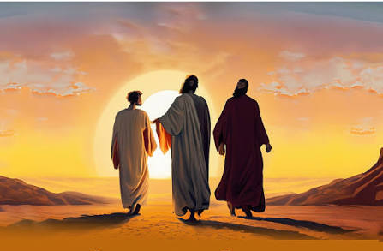
Who Am I?
Walking With Our Master…

Slide 3

Therefore, since we have so great a cloud of witnesses surrounding us, let us also lay aside every encumbrance and the sin which so easily entangles us, and let us run with endurance the race that is set before us, 2 fixing our eyes on Jesus, the author and perfecter of faith, who for the joy set before Him endured the cross, despising the shame, and has sat down at the right hand of the throne of God. 3 For consider Him who has endured such hostility by sinners against Himself, so that you will not grow weary and lose heart.
Hebrews 12:1-3
What Does That Mean?
Fixing Our Eyes On Jesus…

Slide 4
7 In the days of His flesh, He offered up both prayers and supplications with loud crying and tears to the One able to save Him from death, and He was heard because of His piety. 8 Although He was a Son, He learned obedience from the things which He suffered. 9 And having been made perfect, He became to all those who obey Him the source of eternal salvation,
Hebrews 5:7-9
What Does That Mean?
Fixing Our Eyes On Jesus…

Slide 5

What Did Jesus Do?
WDJD

Slide 6

Study Of The Bible Is not about…
determining what Scripture says
but Is about Discovering What It Says.
It Is Already Determined!

Slide 7
We Have God’s Complete Revelation In The Preserved Word.
“The Bible Is Not About The Will Of God”
“It Is The Will Of God”

Slide 8
He Will Guide You Into All Of The Truth…
The Nature Of Evidence…
It Is What It Is:
May Not Come Like I Want It To..
Consider Gnostic, Jewish and Ascetic Philosophies and Influence.

Slide 9
He Will Guide You Into All Of The Truth…
Error
Truth
Add
Beyond
Subtract
Alter Word
Distort
Add
Beyond
Subtract
Alter Word
Distort
Error
Error
Error
Gal. 1:6-11; 2 Jn. 1:9; Rev. 22:18-19; 1 Cor. 4:6
Consider: Gnostic, Jewish, Ascetic Philosophies and Influence.
Col. 2:8, 2:16-17, 20-23; 2 John 1:9-11; 1 John 4:2-5; 1 Tim. 4:1-5

Slide 10

Snapshots of Complete Truth Revealed
12 “I have many more things to say to you, but you cannot bear them now. 13 “But when He, the Spirit of truth, comes, He will guide you into all the truth; for He will not speak on His own initiative, but whatever He hears, He will speak; and He will disclose to you what is to come. 14 “He will glorify Me, for He will take of Mine and will disclose it to you.
John 16:12-14

Slide 11
Snapshots of Complete Truth Revealed
24 “He who does not love Me does not keep My words; and the word which you hear is not Mine, but the Father’s who sent Me. 25 “These things I have spoken to you while abiding with you. 26 “But the Helper, the Holy Spirit, whom the Father will send in My name, He will teach you all things, and bring to your remembrance all that I said to you.
John 14:26

Slide 12
Snapshots of Complete Truth Revealed
Beloved, while I was making every effort to write you about our common salvation, I felt the necessity to write to you appealing that you contend earnestly for the faith which was once for all handed down to the saints.
Jude 1:3

Slide 13
Snapshots of Complete Truth Revealed
But the Spirit explicitly says that in later times some will fall away from the faith, paying attention to deceitful spirits and doctrines of demons, 2 by means of the hypocrisy of liars seared in their own conscience as with a branding iron, 3 men who forbid marriage and advocate abstaining from foods which God has created to be gratefully shared in by those who believe and know the truth.
1 Tim. 4:1-3

Slide 14
Snapshots of Complete Truth Revealed
I solemnly charge you in the presence of God and of Christ Jesus, who is to judge the living and the dead, and by His appearing and His kingdom: 2 preach the word; be ready in season and out of season; reprove, rebuke, exhort, with great patience and instruction. 3 For the time will come when they will not endure sound doctrine; but wanting to have their ears tickled, they will accumulate for themselves teachers in accordance to their own desires, 4 and will turn away their ears from the truth and will turn aside to myths.
2 Tim. 4:1-4

Slide 15

1 John 2:19
They went out from us, but they were not really of us; for if they had been of us, they would have remained with us; but they went out, so that it would be shown that they all are not of us.
1 John 2:19
and with all the deception of wickedness for those who perish, because they did not receive the love of the truth so as to be saved. 11 For this reason God will send upon them a deluding influence so that they will believe what is false, 12 in order that they all may be judged who did not believe the truth, but took pleasure in wickedness.
2 Thessalonians 2:10-12
There Must Be…
1 Corinthians 11:19

Slide 16

Avalanche Of Influences..
Blogs
AI
Facebook
YouTube
Music
Books
Tradition…
Rev. 12:9
2 Tim. 3:1-5
The Old Deceiver: Genesis - Revelation

Slide 17
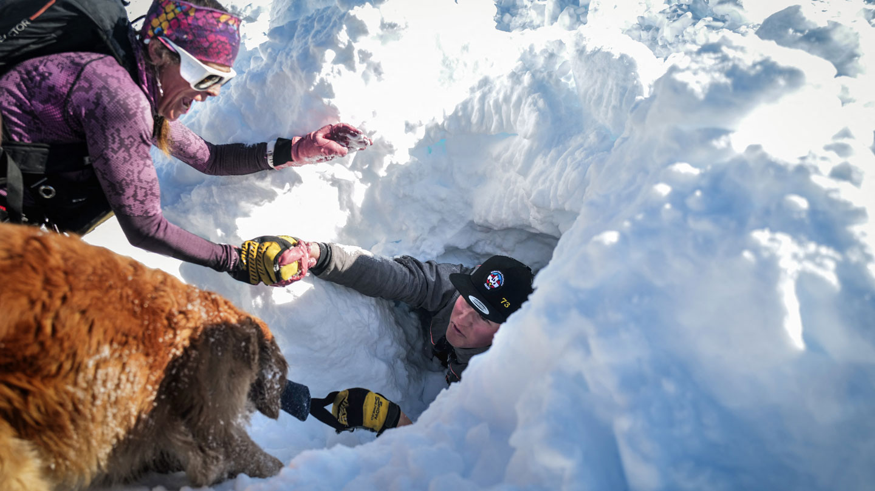

Protection Provided
Providence Of God
God’s Given Truth
Scriptural Warnings
Love Of The Truth
Love Of The Brethren…
Told Eve What She Wanted To Hear
Genesis 2-3

Slide 18
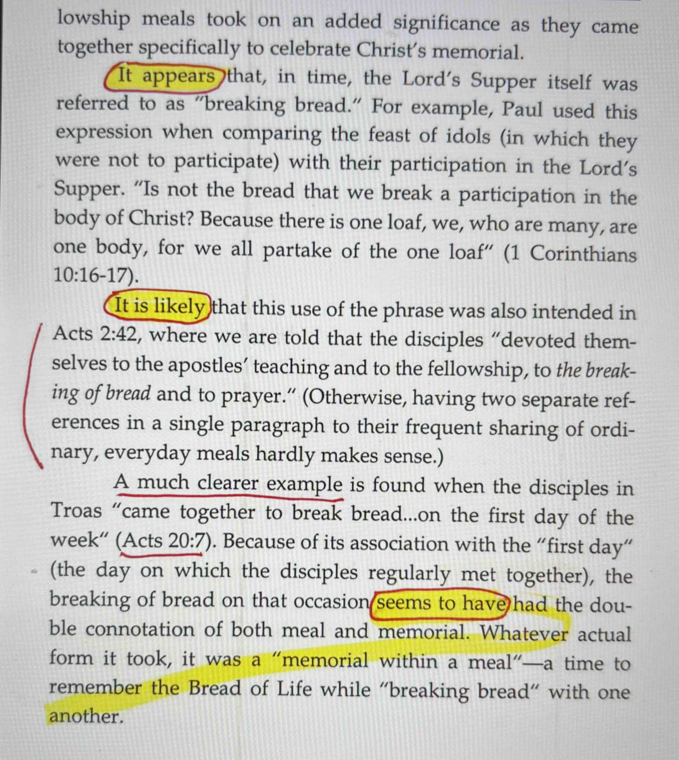

“The Blind Watchmaker”
Richard Dawkins
Observations By
LaGard Smith Ch. 2
In His Book…
“What Every Woman Wants”
Then He
Does This…

Slide 19
How To Restore God’s Ways.
God’s Complete Will
Made Known
God’s Complete Will
Made Known
Let no one in any way deceive you, for it will not come unless the apostasy comes first, and the man of lawlessness is revealed, the son of destruction,
2 Thess. 2:3
Apostasy
(Leaving God’s Way)
Restoration
(Returning To God’s Way)
OT Examples:
Josiah
Nehemiah
1 Tim. 4:1-3

Slide 20
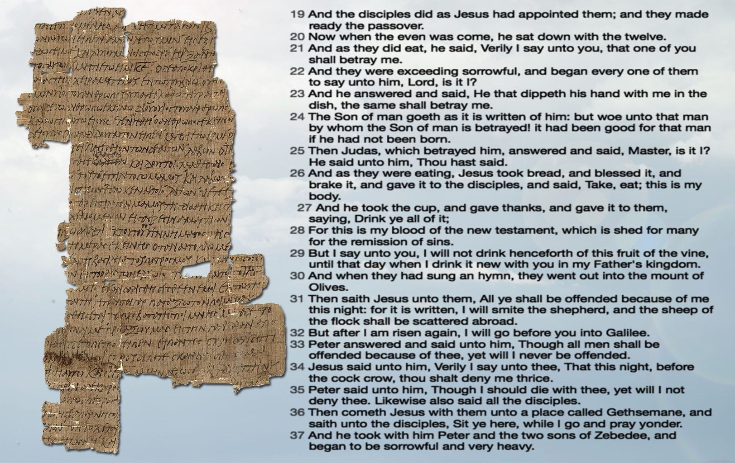
How To Restore God’s Ways?
And a lawyer stood up and put Him to the test, saying, “Teacher, what shall I do to inherit eternal life?”
26 And He said to him, “What is written in the Law? How does it read to you?”
27 And he answered, “YOU SHALL LOVE THE LORD YOUR GOD WITH ALL YOUR HEART, AND WITH ALL YOUR SOUL, AND WITH ALL YOUR STRENGTH, AND WITH ALL YOUR MIND; AND YOUR NEIGHBOR AS YOURSELF.”
28 And He said to him, “You have answered correctly; DO THIS AND YOU WILL LIVE.”
Luke 10:25-28
What Does The Word of God Actually Say and Teach?
“Every Word That
Proceeds From The Mouth Of God…”
Matt. 4:4

Slide 21
How Do You Know The Truth?
1 John 3:18-24
1 John 4:1-21 (Three Tests)
1 John 1:5-2:6 Walking In The Light.
Matthew 5:15-29 Fruits…

Slide 22
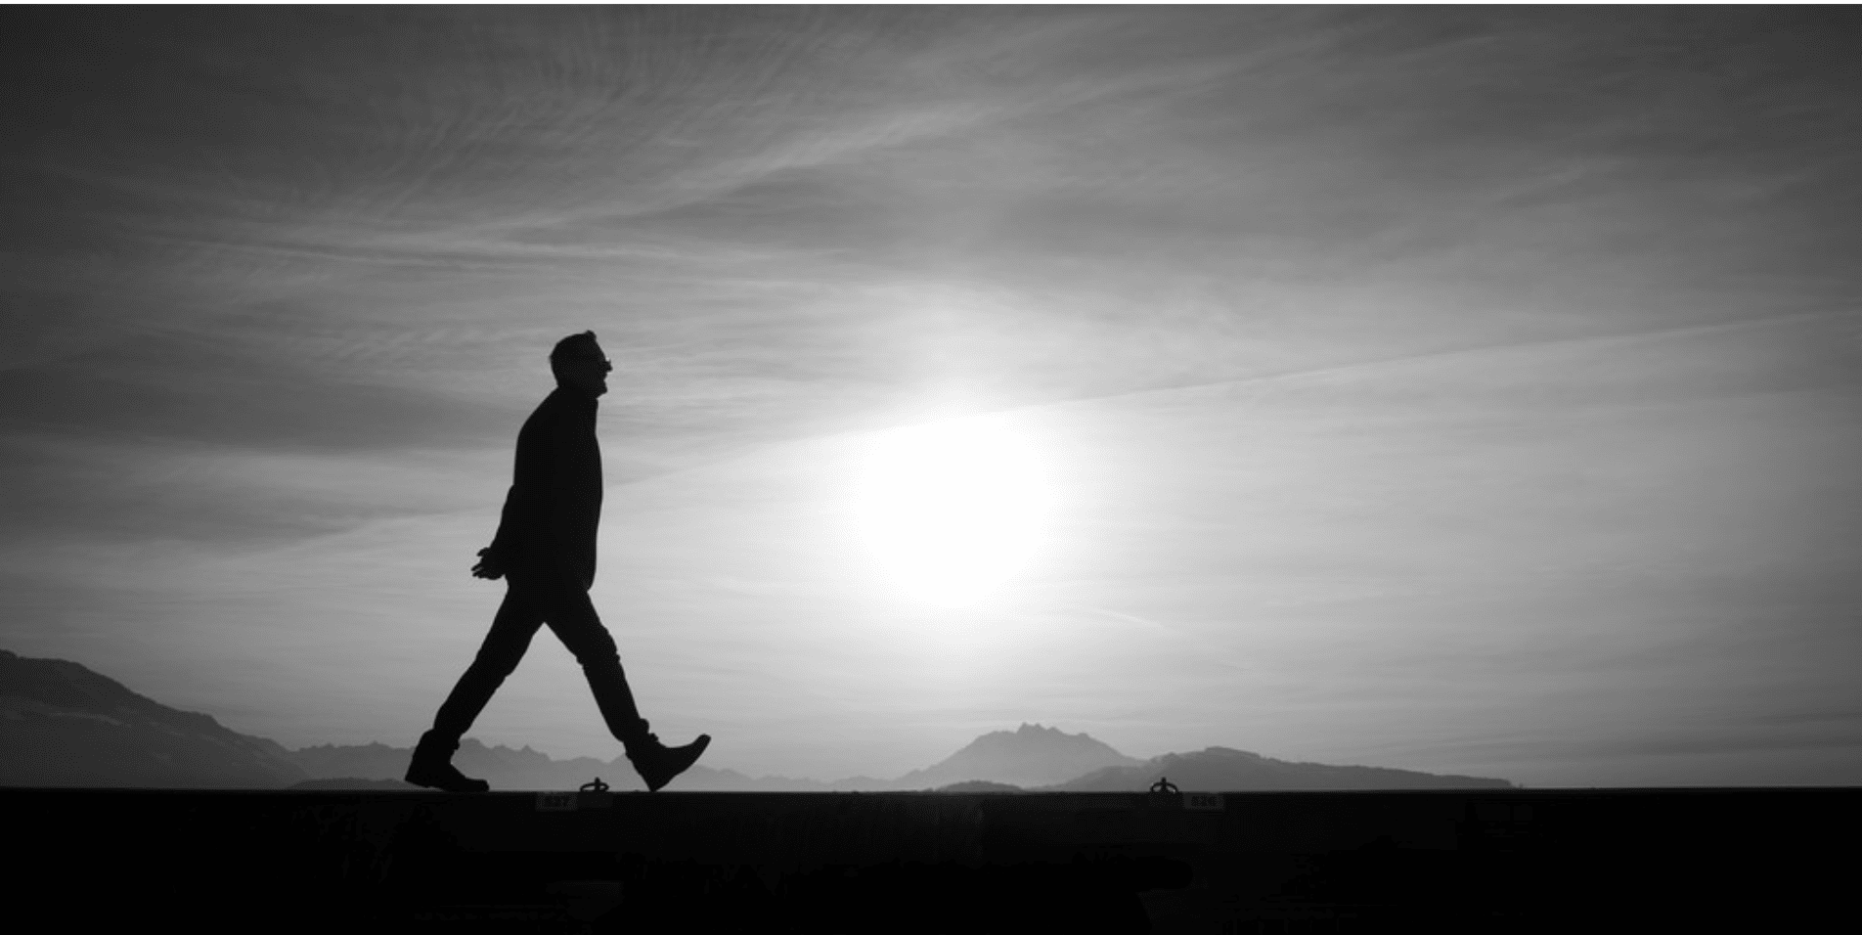
For this reason I have sent to you Timothy, who is my beloved and faithful child in the Lord, and he will remind you of my ways which are in Christ, Just As I Teach Everywhere In Every Church.
1 Corinthians 4:17

Slide 23
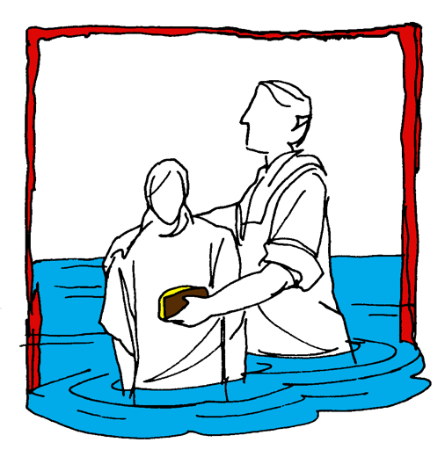


Hear (Rom. 10:17)
Believe (Jn. 8:24)
Repent (Acts 2:38)
Confess (Mt. 10:32-33)
Baptism (Acts 22:16)
Mk. 16:
15-16
Continue… (Matt. 28:20)
Committed To Follow Jesus

